Slide 1



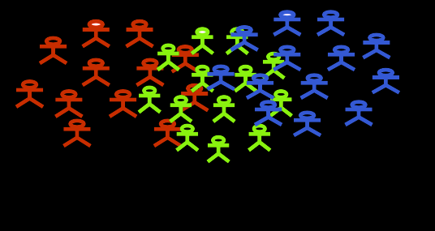
PROJECT:
EPIDEMIX
Agent-Based Modeling
Transmission Dynamics of Meningitis

Slide 2

Overview
Introduction
Objectives
Basics of Epidemiological Modeling
Introducing Agent-Based Modeling (ABM)Strategy
Why ABM
Integrating SIR and ABM
Simulation Details
Intervention Strategies
Results and Analysis Simulation Outcomes
Discussion Interpretation of Results
Challenges and Limitations
Questions and Answer

Slide 3
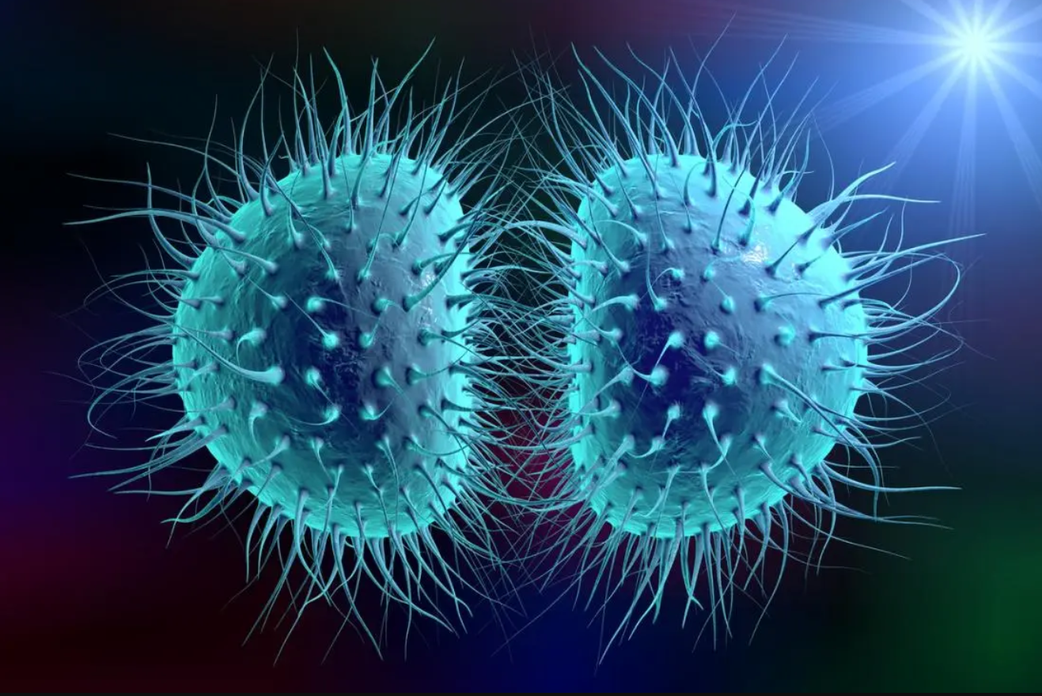

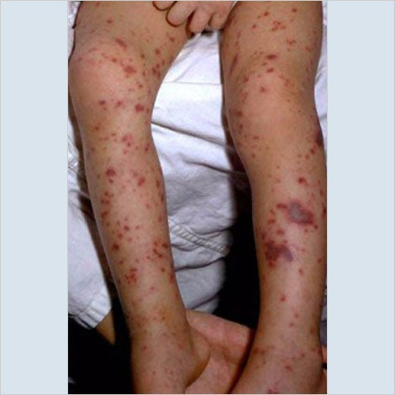
MENINGOCOCCAL MENINGITIS
Meningitis is the inflammation of brain and spinal cord membranes. It can be bacterial, viral, or fungal, with bacterial meningitis, particularly from Neisseria meningitidis, being the most severe - in African Meningitis belt.

Slide 4

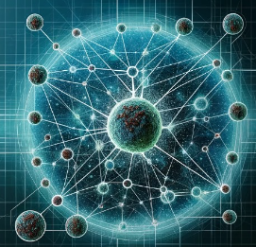
Objectives:
Simulate Disease Transmission
with Agent-Based Modeling (ABM)
Use advanced algorithms to model scenarios and predict disease dynamics.
Simulation Development
Create an ABM system to simulate infectious disease spread.
Assess Men5CV Vaccine Impact
Analyze simulation results to gain insights and recommend public health interventions.

Slide 5
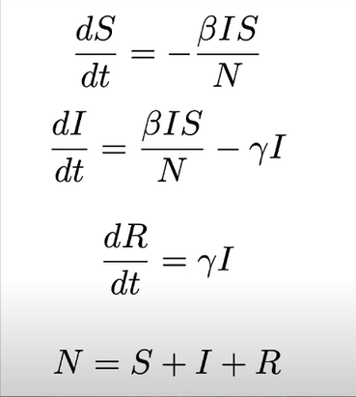
Basics of Epidemiological Modeling
We use compartmental models to mathematically model Infectious disease transmission.
S, I, or R, (Susceptible, Infectious, or Recovered). People may progress between compartments.
S: The number of
susceptible individuals.
The core of our simulation model is structured around the SVEIDRS (Susceptible, Vaccinated, Exposed, Infected, Recovered, Susceptible) paradigm, designed to capture the entire lifecycle of meningococcal disease transmission and immunity within a population.
I: The infectious individuals.
R Removed (and immune)
or deceased individuals

Slide 6
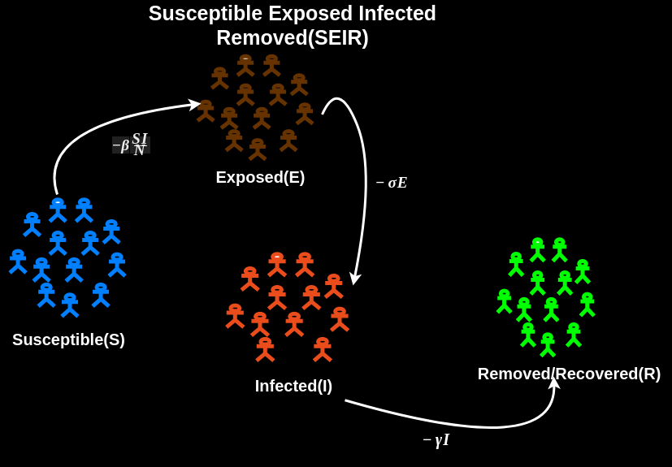
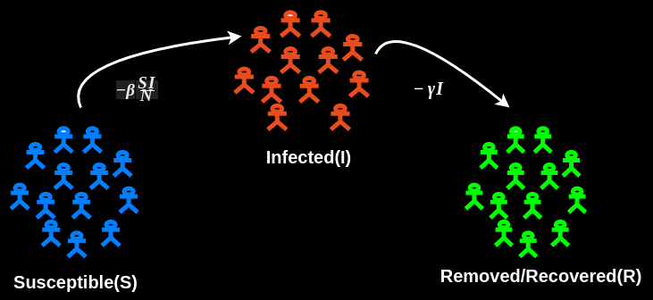
Basics of Epidemiological Modeling
Depicts different compartment variations based on the disease and modeling goals, which can become more complex in a real world.

Slide 7
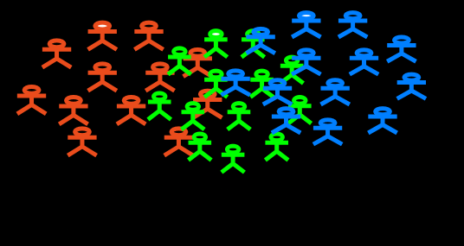
AGENT-BASED MODELING
Agent-Based Modeling (ABM) is a computational modeling approach that simulates the actions and interactions of autonomous agents to assess their effects on a system as a whole.
SIMULATION ENVIRONMENT
WHY ABM?
Agents: Autonomous Individual entities with distinct characteristics and behaviors.
Dynamic Interactions:
models complex interaction networks
Rules: Guidelines that govern the behavior﻿ and interactions of agents.
Environment: The space where agents interact, which can be spatial or abstract.

Slide 8
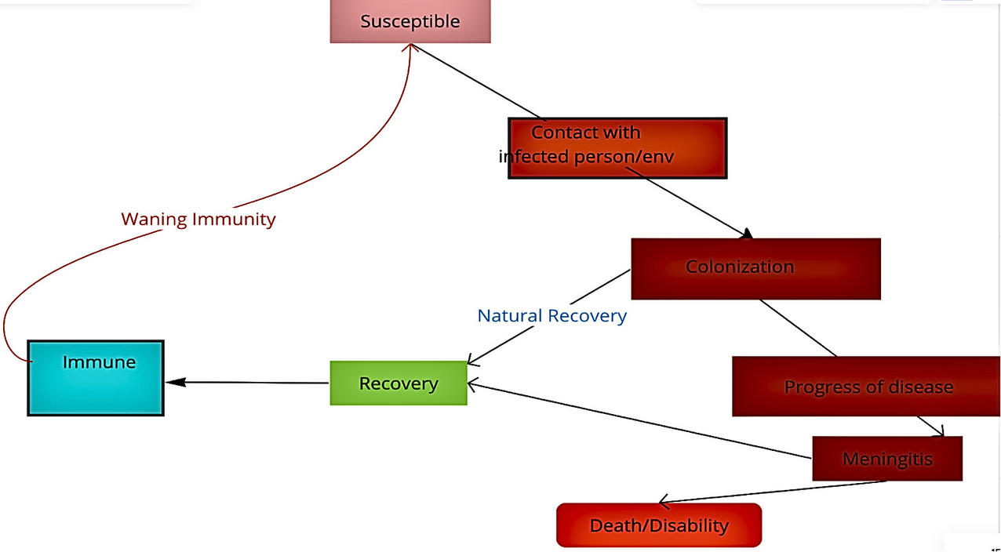
Integration of SIR and ABM
Integrate ABM with SIR model
Use Starsim Python package
Adopt SVEIDRS structure
Incorporate demographic and geographic data
Derive epidemiological parameters

Slide 9
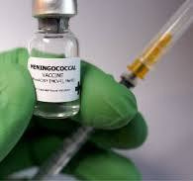

Public Health Interventions: Combating Infection
Public health interventions are essential for controlling and preventing disease by interrupting transmission and protecting individuals and communities.
Vaccine
Treatment
20%
10%
Reduction Threat/Infection
Lower Death Rates
20%
15%
Recoveries
Reduced Exposure

Slide 10
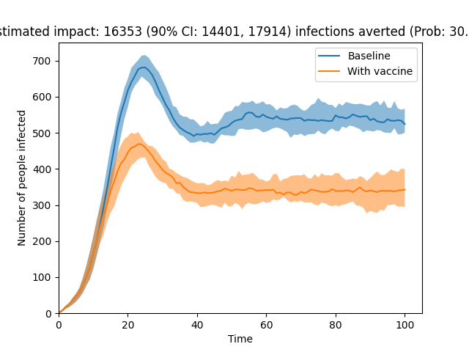
Vaccination
Vaccines - introduce a weakened or inactive pathogen to stimulate the immune system, developing antibodies for future protection.
Vaccination - aims for herd immunity, protecting the unvaccinated by immunizing a significant portion of the population.

Slide 11
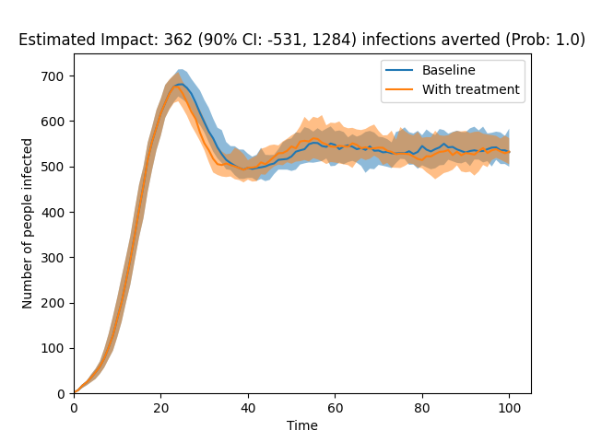
Treatment
Providing timely and effective medical care to infected individuals influences the overall infection dynamics
100%
10%
Trying to eliminate Infection
Impact on Mortality Rates
20%
75%
Prevention of Complications
Improving Recoveries

Slide 12
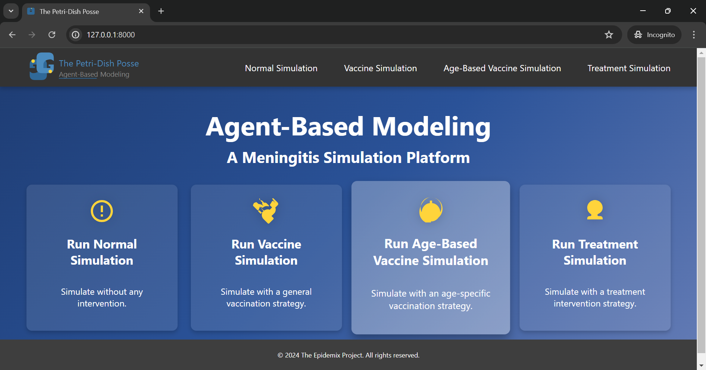
User Interface: Dashboard

Slide 13

Q & A
The Epidemix Team

Slide 14




From:
The Epidemix Team
THANK YOU
For watching this presentation
0712726239
thepetridishposse@gmail.com
epidemix.jhubafrica.com
Juja, Nairobi, Kenya

